Slide 1
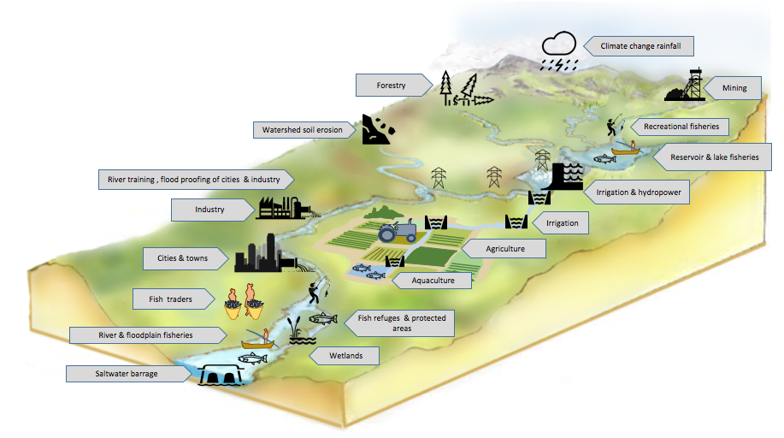
Inland fisheries…the bigger picture
Notes:
Session 2 slide 10

Slide 2
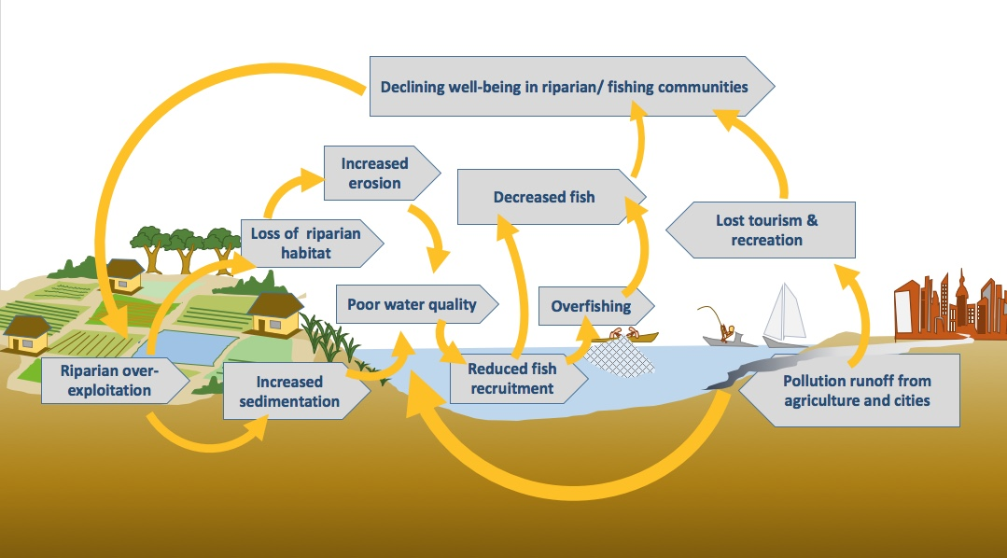
Ecosystem linkages
Notes:
Session 2 slide 13

Slide 3
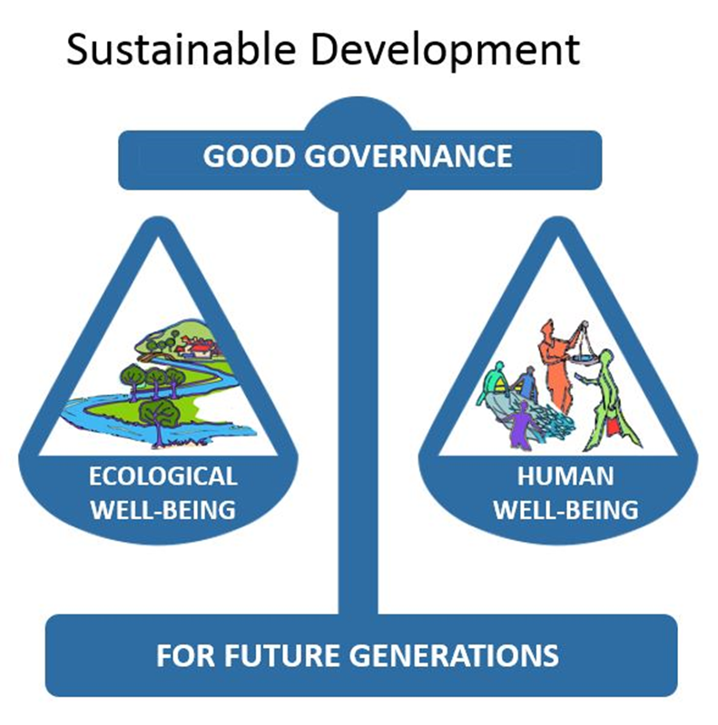
“Development which meets the needs of the present without compromising the ability of future generations to meet their own needs.”
Notes:
Balance: Session 2 slide 16; quote sustainable development :Session 2 slide 18
Balance repeated in Session 3 slide 4

Slide 4
Ecological well-being
3 Components of EAFm
EAFm
Good Governance
Human well-being
Note: Ecological well-being = fish + environment
Notes:
Session 3 slide 5

Slide 5
Notes:
Session 4 slide 4

Slide 6
Co-management
“Partnership arrangements between key stakeholders and government to share the responsibility and authority for the management of the fisheries and coastal resources, with various degrees of power sharing.”
Notes:
Session 4 slide 15 (the institutions)
Co management quote from session 9 slide 11

Slide 7
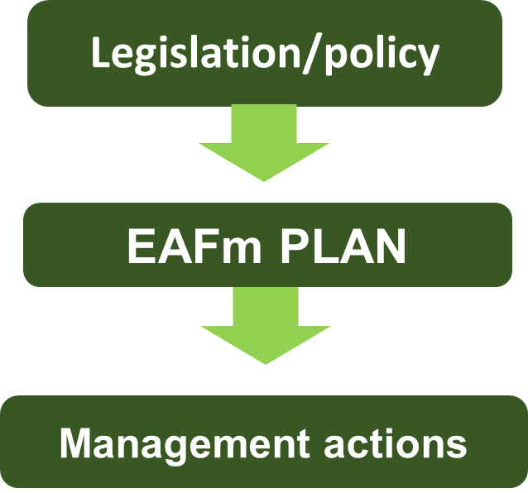
EAFm Plan:
Linking legislation & policy to actions
Sustainably managed fisheries
Limit fishing effort in lake nursery areas
Enforce close season and control number of illegal fishing gears
Notes:
Session 6 slide 5 ; visual from session 6 slide 8

Slide 8
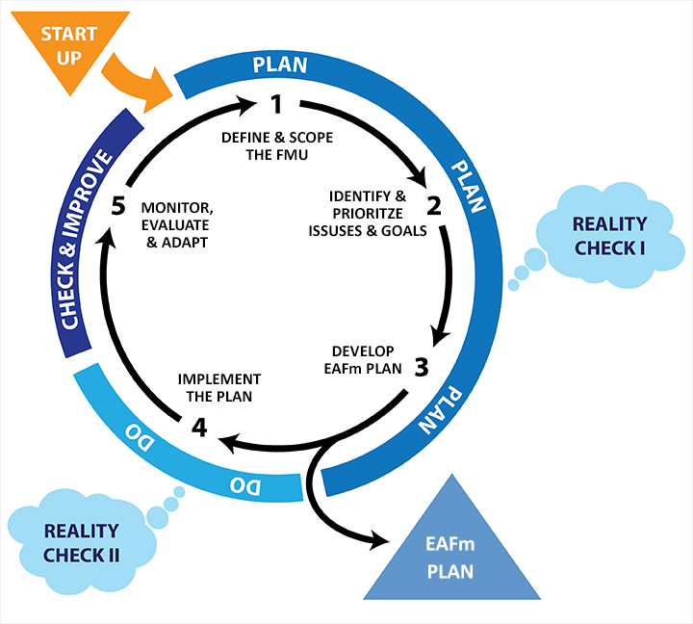
The 5 steps of the EAFm
Notes:
Session 7 slide 3

Slide 9
Possible stakeholders
Government
Fisheries
Environment
Advisors & Advocacy
NGOS,
Traditional leaders,
Researchers, Academics
Fishers
Fisher associations
EAFm
Other Users
Irrigation, Agriculture, Recreational fishing, Tourism, Conservation
Fisheries dependents
Boat owners, Processors, Traders, etc
MCS
Fishery patrol, Protection patrol
Notes:
Session 8 slide 9

Slide 10
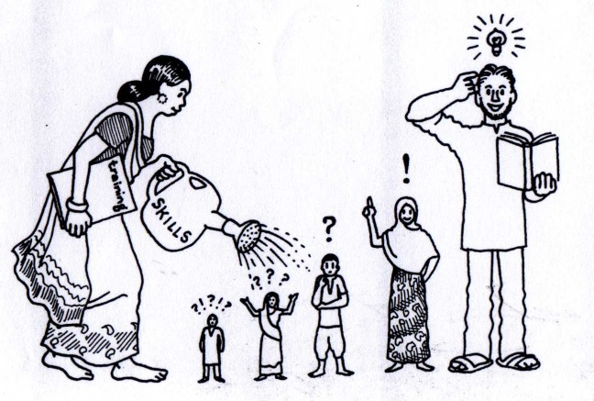
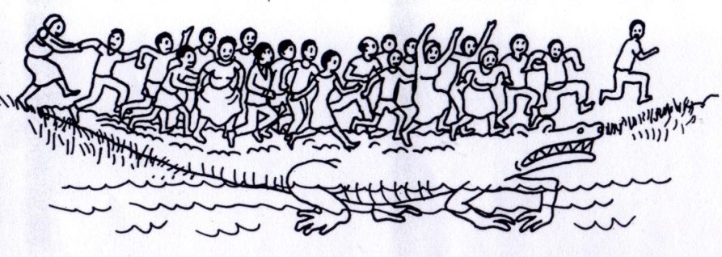
The active PARTICIPATION of people is at the heart of EAFm
Identify trade-offs
Agree on issues
and solutions
Group trust
Empowerment
Awareness raising
Ownership
Notes:
Session 9 slide 7 and quote session 9 slide 5
10

Slide 11
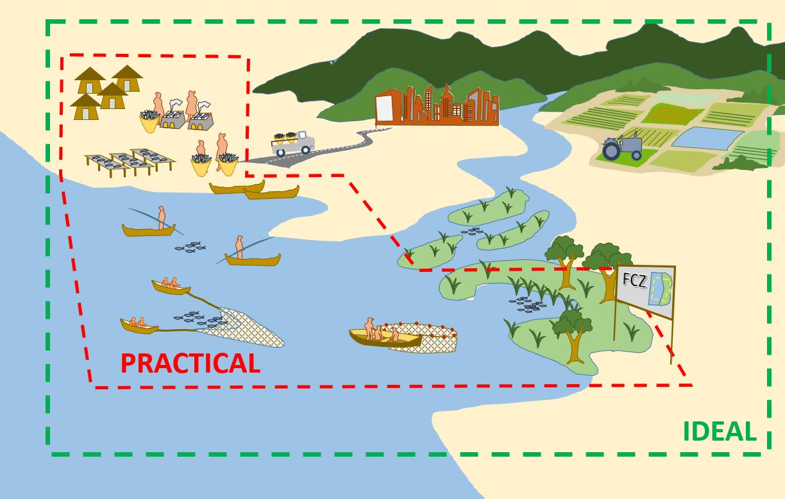
Ideal versus practical FMU
Notes:
Session 10 slide 6

Slide 12
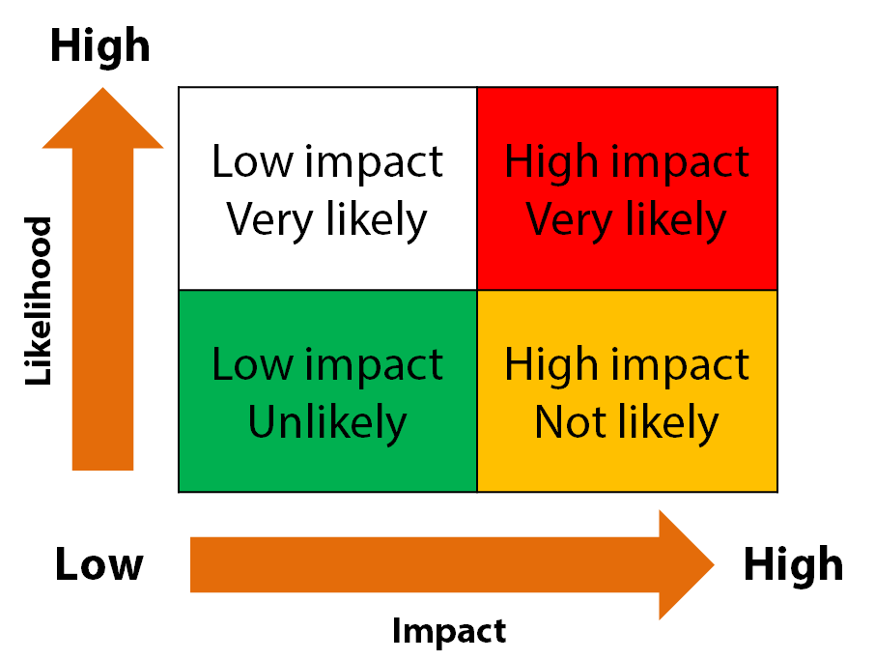
Notes:
Session 11 slide 14 Prioritization based on risk

Slide 13
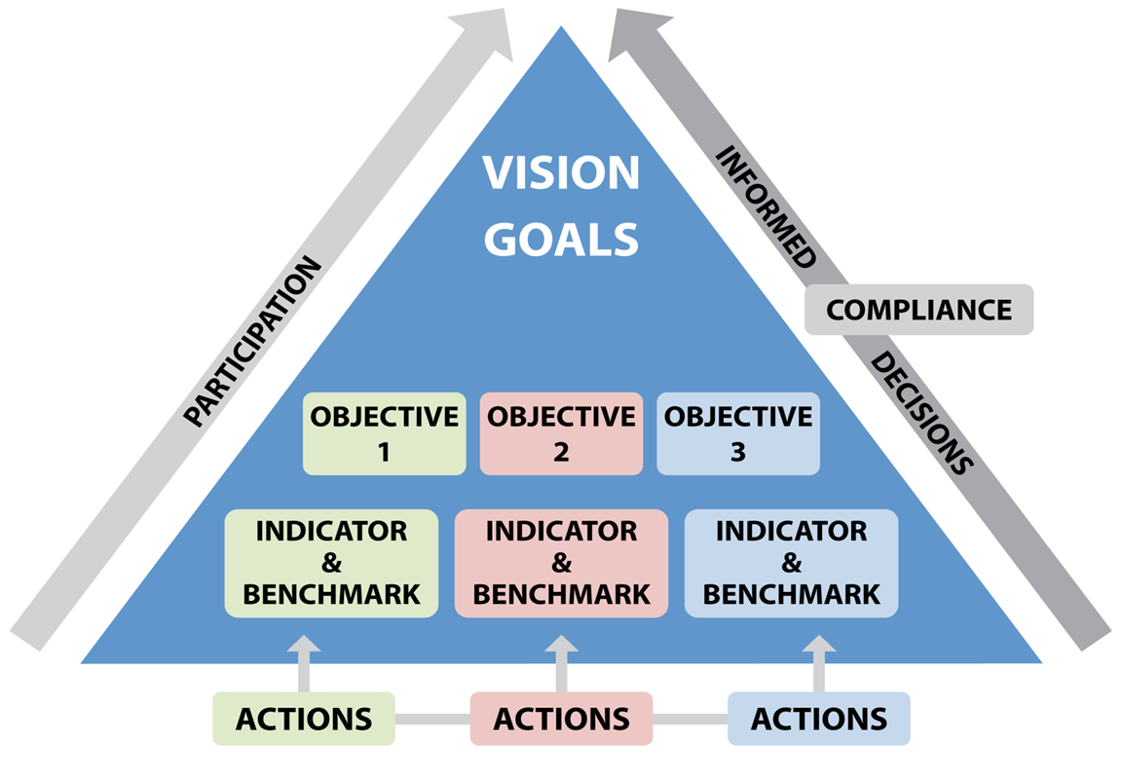
GOAL
FINANCE
Notes:
Session 14 slide 4

Slide 14
EAFm Plan outline
FMU name
1. Vision (Step 1)
2. Background (Step 1)
3. Major threats and issues (Step 2)
4. Goals (Step 2)
5. Objectives, indicators and benchmarks (Step 3)
6. Management actions (Step 3)
7. Compliance (Step 3)
8. Data and info needs (Step 3)
9. Financing (Step 3)
10. Review of the plan – frequency of reviews
Notes:
Session 14 slide 22

